Slide 1
The 215th anniversary of veterinary education in Russia
university's anniversary
Saint-Petersburg State University of Veterinary Medicine
2023
SPbSUVM

Slide 2
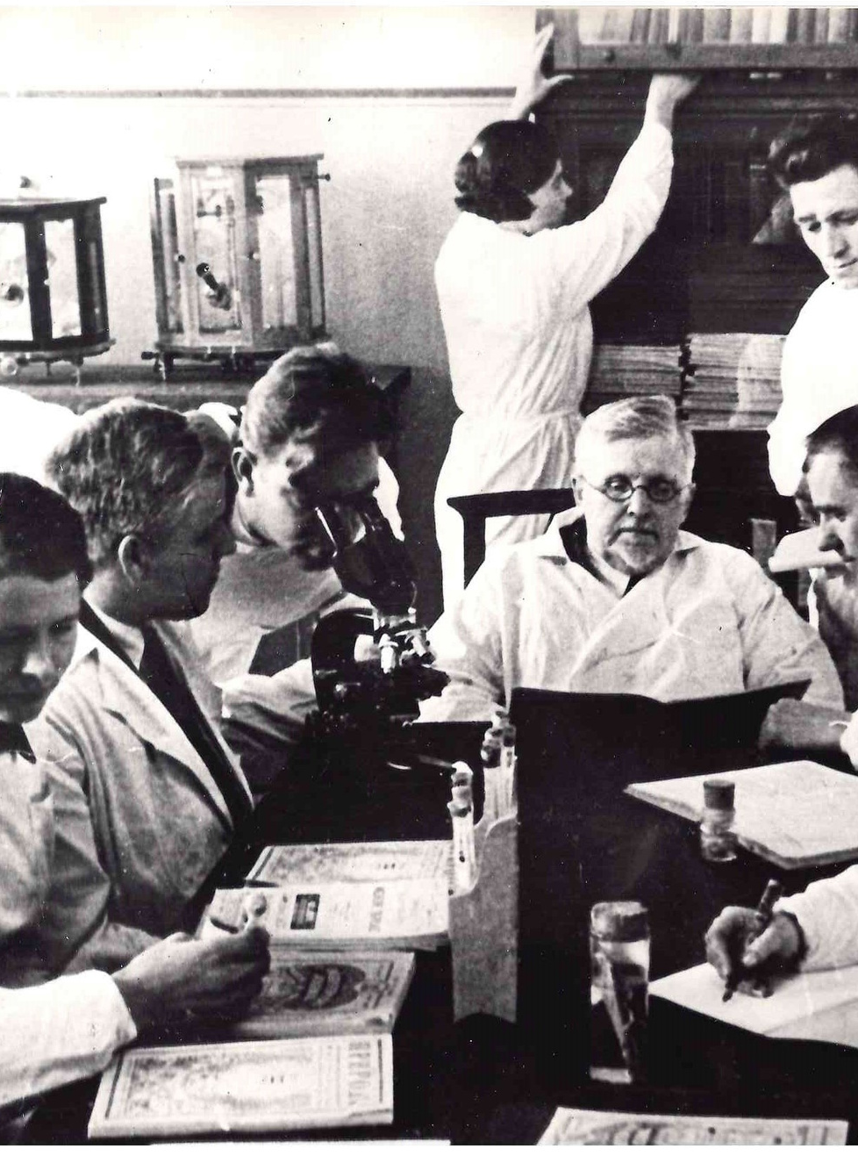
The 215th anniversary of veterinary education in Russia
History
The veterinary university is deservedly considered to be the oldest, having been founded in 1808. It was during that period that new university faculties were established at Medical-Surgical Academy in Petersburg.
Over the 215-year existence the university went through numerous reforms. In 1919 its name was changed to the Petrograd Veterinary and Zootechnical Institute. The first chancellor is V. L. Yakimov.
In 1923, the zootechnical department was terminated, and the institute became one field. As a result of renaming the city in 1924, the name of the institute was replaced by the Leningrad Veterinary Institute.
In 1992, the institute was renamed the Saint-Petersburg Veterinary Institute, which later changed to the Saint-Petersburg State Academy of Veterinary Medicine (SPbSAVM) in 1994.
In 2020, the academy was granted the title of a university. Since that moment, the university has been known as the Saint-Petersburg State University of Veterinary Medicine.
The current chancellor is a professor, corresponding member of RAS, and a Russian scientist in animal genetics and breeding, К. V. Plemyashov.
1808
1919
1924
1994
2020
2023
SPbSUVM

Slide 3
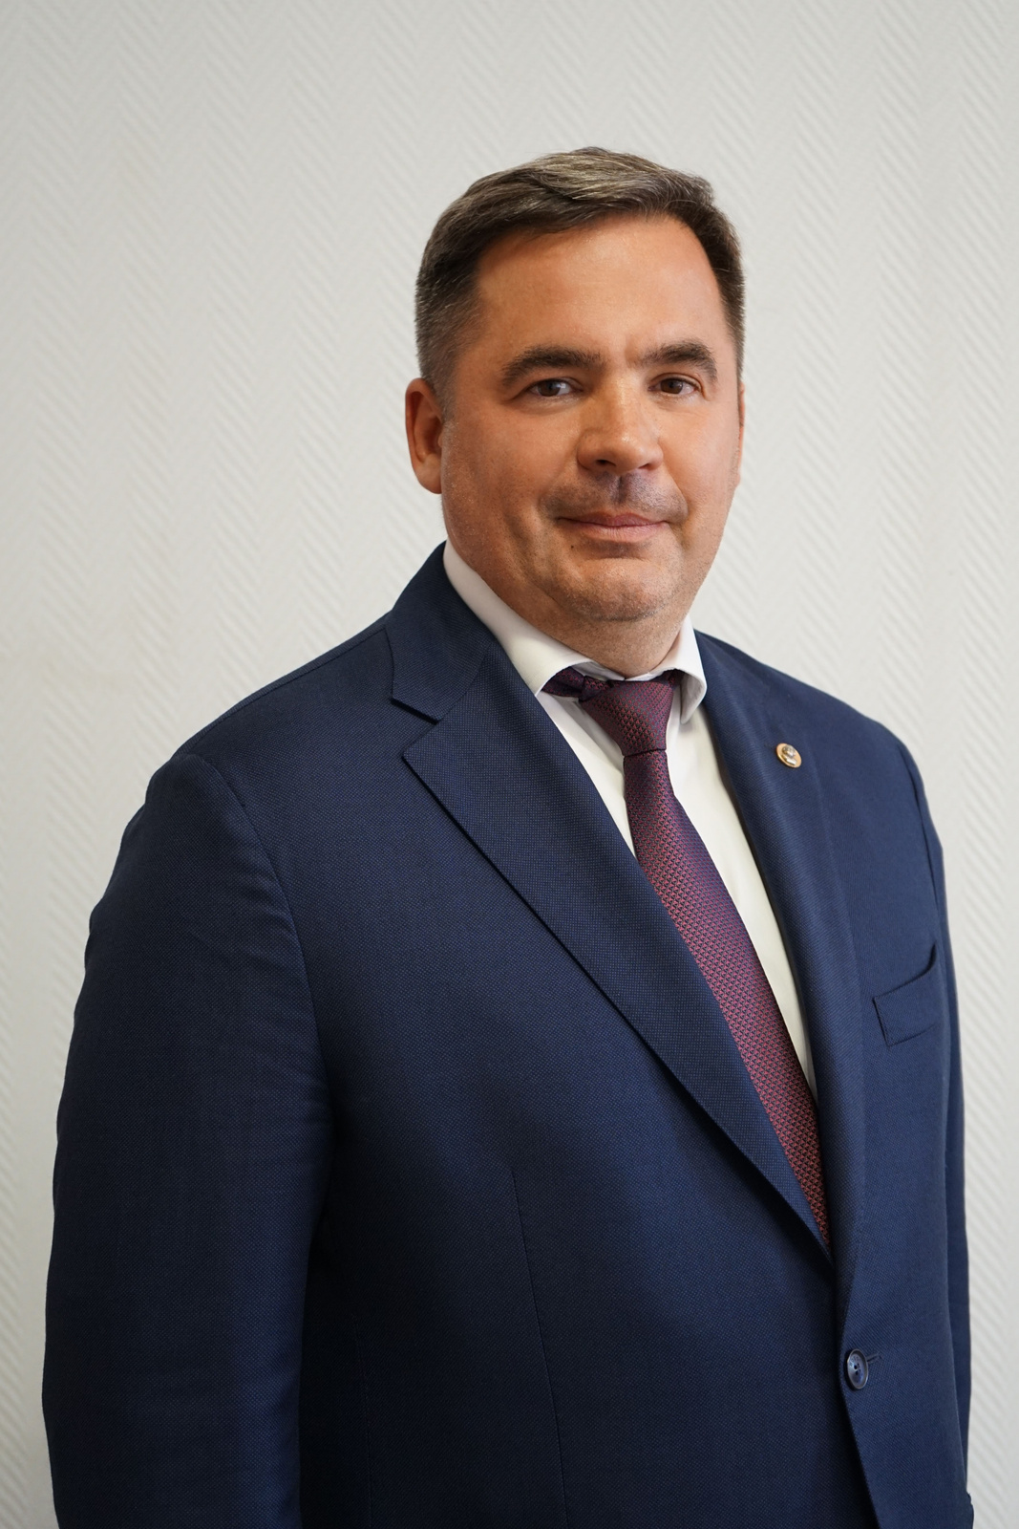
#СПБГУВМ
The 215th anniversary of veterinary education in Russia
Our mission,
Development strategy
#НОВАТОРСТВО
Our goal is to become the centre of veterinary education in Russia, to achieve scientific breakthroughs for practical uses in society, to maintain the health of animals to ensure a sustainable environment, and to train professionals capable of working effectively and successfully in a rapidly changing technological world.
Invest in education!
Invest in education!
2023
SPbSUVM

Slide 4
The 215th anniversary of veterinary education in Russia
About university
80%
№1
150
600+
in the RAEX rating —
Leader in Veterinary and Zootechnics
Of academic staff have academic degree
million rubles were won by the university for the start-up studio development
publications in scientific journals Web Science, SCOPUS
3000
10
3
42
ТЫС.
students study at 4 faculties and 23 departments of the university
innovative research laboratories and centers
dissertation committees for the defense of candidates and doctoral papers
square meters is the total area of university buildings

Slide 5
The 215th anniversary of veterinary education in Russia
Veterinary
Qualification – specialist
Mode of study: full-time, part-time, distance
1
A veterinarian deals with the treatment and prevention of animal diseases.
Veterinary and sanitary examination
A veterinary-sanitary expert deals with the prevention of diseases in humans and animals
2
Qualification – bachelor
Mode of study: full-time, part-time, distance
education
Biology
Graduates work in environmental management, and human ecology in medical institutions.
Qualification – bachelor
Mode of study: full-time
3
Aquaculture
In this field, specialists are trained to study the state of the ecosystems of water bodies and the artificial cultivation of hydrobionts.
4
Qualification – bachelor
Mode of study: full-time
2023
SPbSUVM

Slide 6
science and innovation
150 million per year for start-ups
Journal included in the RSCI
10 RSF projects for a total of 26 million per year
Forming a pedigree nucleus in dairy farming
3 dissertation committees
Laboratory of Genetic Research
2023
SPbSUVM
Grant income for 2023 - ₽22 million

Slide 7
University Clinic
The Veterinary Clinic of the St Petersburg State Veterinary University is a modern, well-equipped medical facility for pets, staffed by experienced veterinarians.
Internships in a veterinary clinic provide students with effective communication, encourage teamwork, and help them develop client-focused skills.
Students have the opportunity to develop the practical skills and abilities necessary for future employment by observing the work of specialists and participating in the process of diagnosing and treating animals.

Slide 8
#invest in education
practical training
Clinical training is an essential part of education.
Students work with various animal species, study pathological materials and processes, and master modern equipment.

Slide 9
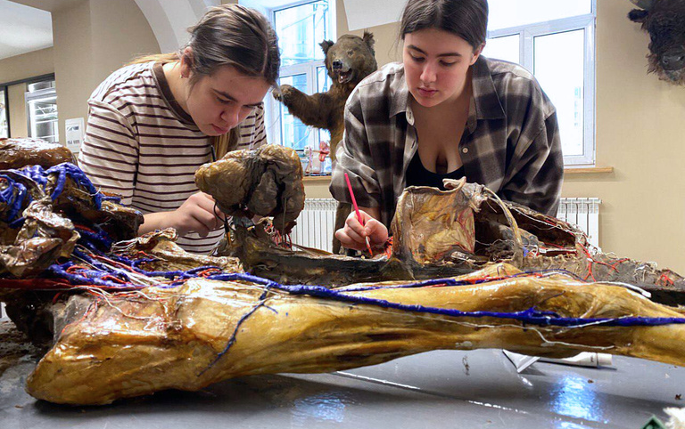
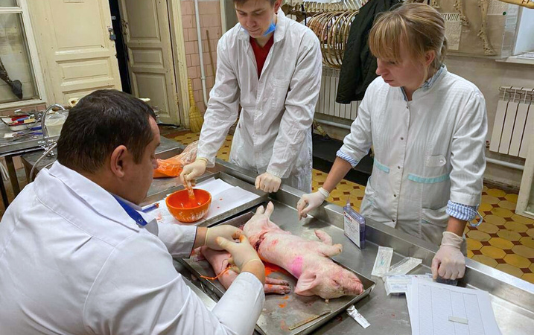
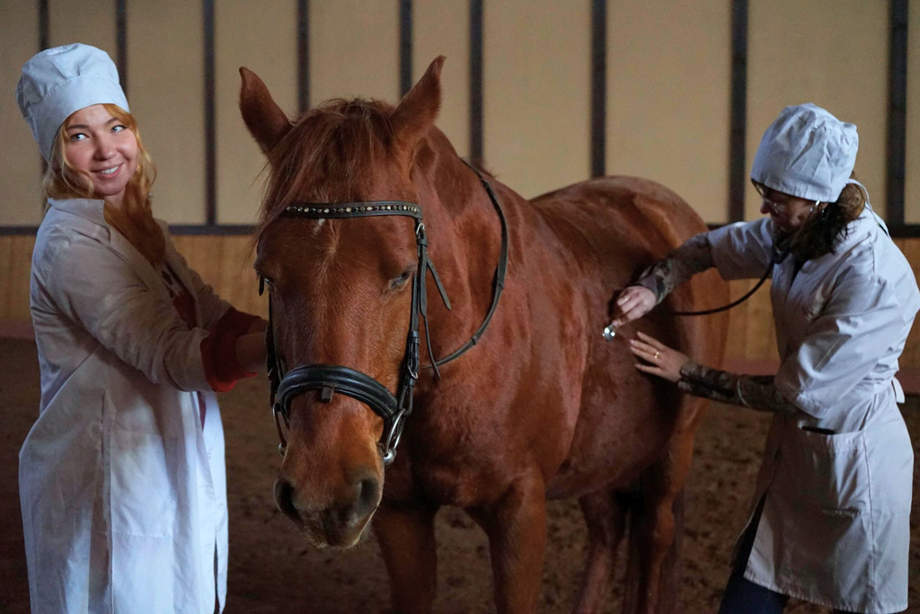
The 215th anniversary of veterinary education in Russia
Unique materials
Practical experience
Undergraduate specializations
The training makes use of pathological material, through which students have an opportunity to study the phenomena and processes that occur in the body.
Students gain work experience under the supervision of professors and practicing veterinarians.
Students attend agro-industrial complex enterprises, which contributes to the choice of students' specialization.
2023
SPbSUVM

Slide 10
The 215th anniversary of veterinary education in Russia
internship at industrial partners’ companies
We thank and honor our graduates who have become partners of our university!
СОЮЗ ЛЕНОБЛМОЛОКО
2023
SPbSUVM

Slide 11
The 215th anniversary of veterinary education in Russia
#invest in education
career guidance work
The University of Veterinary Medicine has extensive experience of working with students and applicants in the field of career advice. Our specialist team arranges different events to help young people make career choices.

Slide 12
The 215th anniversary of veterinary education in Russia
#invest in education
We arrange university tours where children can see lecture and practical classrooms, learn more about science laboratories and clinics, and meet lecturers and students. This experience gives them an understanding of the skills and knowledge that are required to work in this field.
Moreover, we conduct career guidance events at schools and colleges to tell about the majors available at our university. We show what opportunities exist for veterinary graduates and how they can apply their knowledge and skills in practice.
2023
SPbSUVM

Slide 13
The 215th anniversary of veterinary education in Russia
Student Scientific Society
Centre of creative initiatives
youth policy and education
labor union
student council
Volunteer Centre
University youth policy is one of the key elements of students' personality formation. The educational institution does not only provide quality education, it also creates conditions for successful socialization and self-fulfillment of young people, as well as the formation of their values.
One of the key moments of educational activity at uuniversity remains student organizations, which allow students to develop their creative and professional qualities through participation in various curricular and extracurricular activities.
band
CCI
Sport
media Centre
Student agricultural labor detachment
Ecology detachments

Slide 14
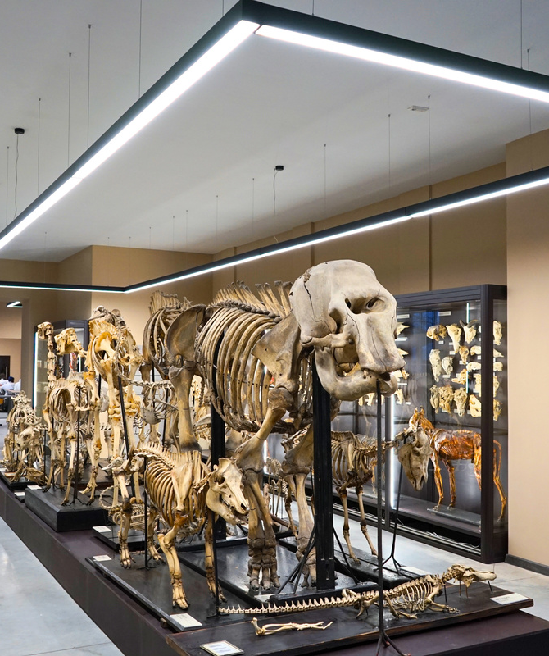
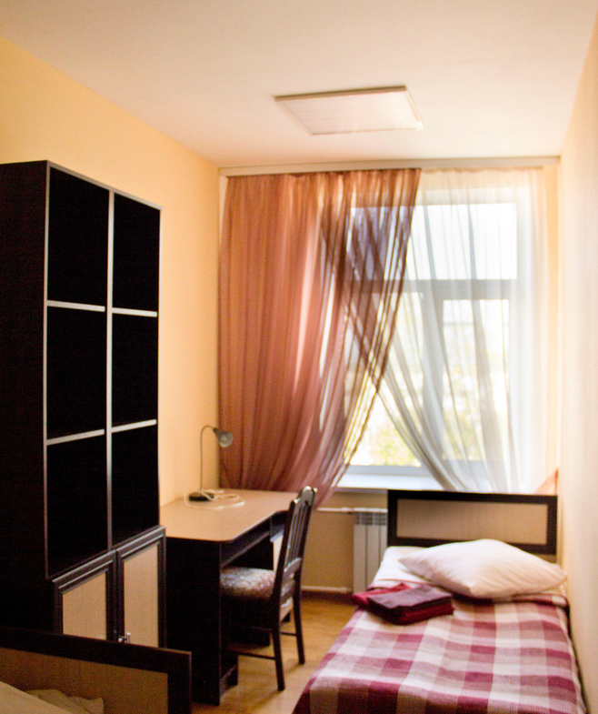
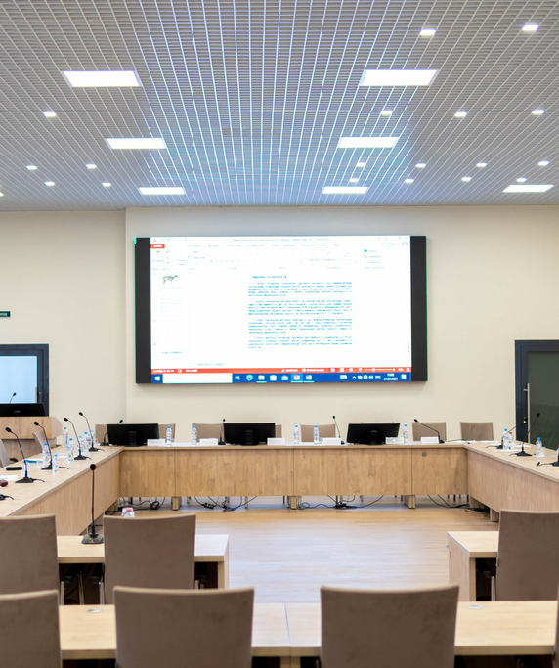
New academic building
Anatomy Museum
Canteen
Dormitory
Conference hall
МТS
The material and technical support of the SPbSUVM is one of the key factors in ensuring the quality of education and research work of the academic staff.
2023
SPbSUVM

Slide 15
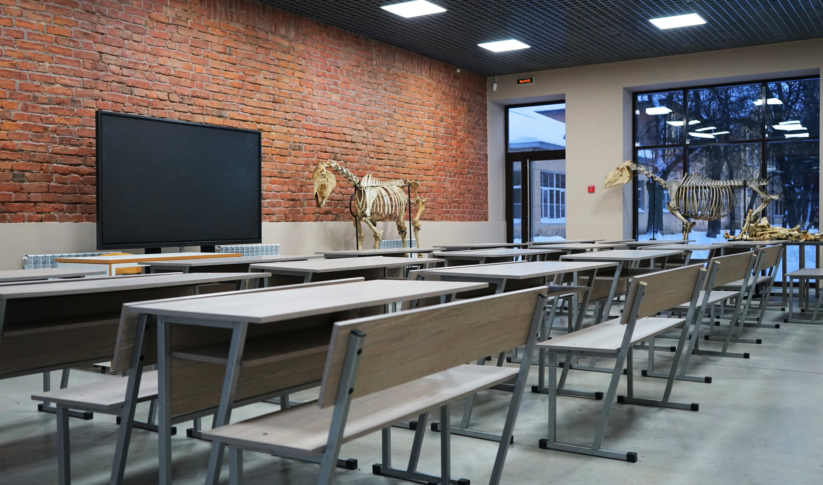
The 215th anniversary of veterinary education in Russia
new classrooms
Creating a modern classroom with 30 seats by renovating the unused garage.

